Slide 1

DATABASE
Database : an organized collection of data and information or interrelated data collected at one place.
As we encounter several activities that involve our interaction with databases, for example in the bank, in the railway station, in school, in a grocery store, etc. These are the instances where we need to store a large amount of data in one place and fetch these data easily.

Slide 2
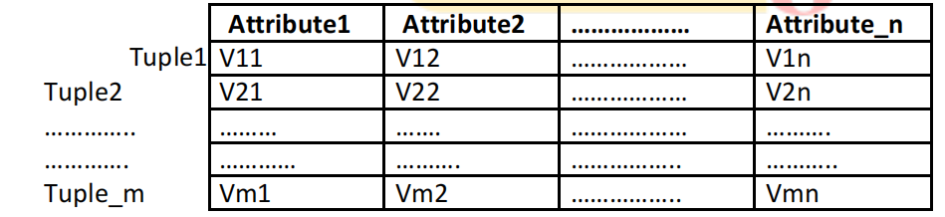
Database Concepts:
For the first look, database seems to be a spreadsheet consisting of multiple sheets. The primary data structures in a database are tables, rows and columns.
In a relational database terminology, tables, rows and columns are referred as relation, tuple and attribute respectively.
Typical structure of a database table is as shown below. Each table may consist of n number of
attributes and m number of tuples (or records). Every tuple gives the information about one individual. Every cell(i, j) in the table indicates value of jth attribute for ith tuple.

Slide 3
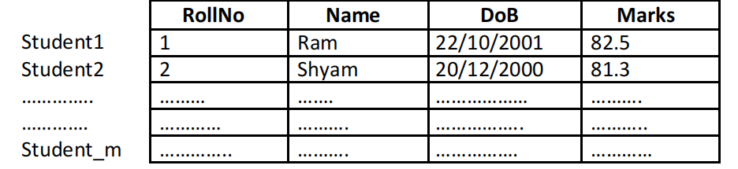
Consider the storing details of students in a database table. The format may look like –
There are softwares that can maintain proper relationships between multiple tables in a single database and are known as Relational Database Management Systems (RDBMS)
Types of databse:
1)Hierarchical databases
2)Network databases
3)Object-oriented databases
4)Relational databases
5)NoSQL databases

Slide 4
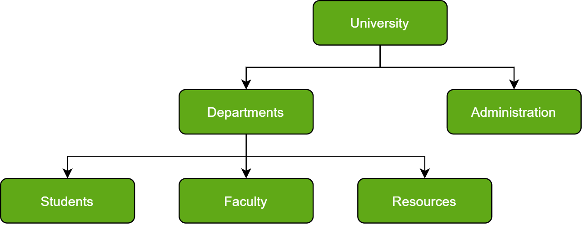
1. Hierarchical Databases :
Just as in any hierarchy, this database follows the progression of data being categorized in ranks or levels, wherein data is categorized based on a common point of linkage. As a result, two entities of data will be lower in rank and the commonality would assume a higher rank.

Slide 5
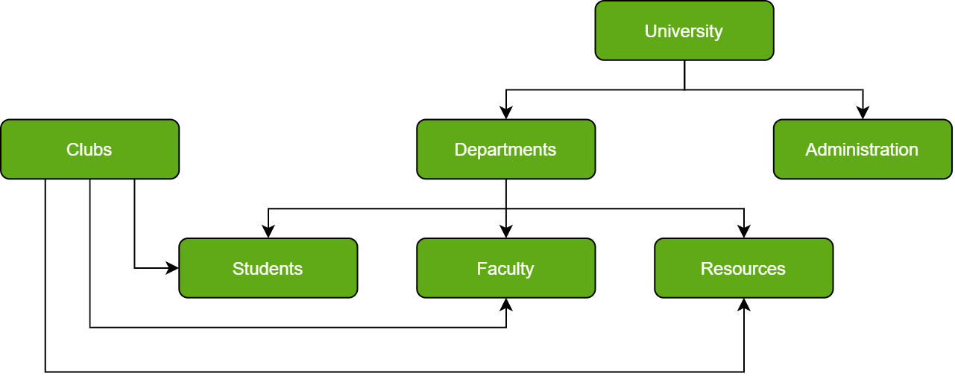
2. Network Databases :
The child records are given the freedom to associate with multiple parent records. As a result, a network or net of database files linked with multiple threads

Slide 6
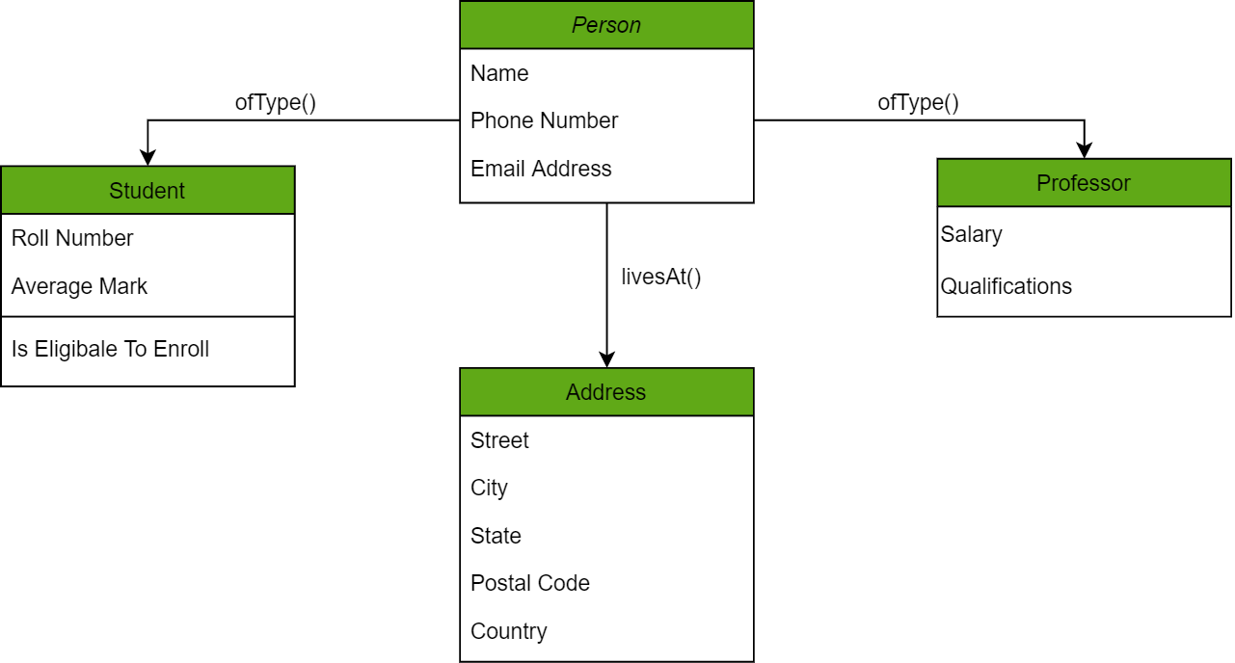
3. Object-Oriented Databases :
Those familiar with the Object-Oriented Programming Paradigm would be able to relate to this model of databases easily. Information stored in a database is capable of being represented as an object which response as an instance of the database model. Therefore, the object can be referenced and called without any difficulty. As a result, the workload on the database is substantially reduced.
In the chart above, we have different objects linked to one another using methods; one can get the address of the Person (represented by the Person Object) using the livesAt() method. Furthermore, these objects have attributes which are in fact the data elements that need to be defined in the database.

Slide 7
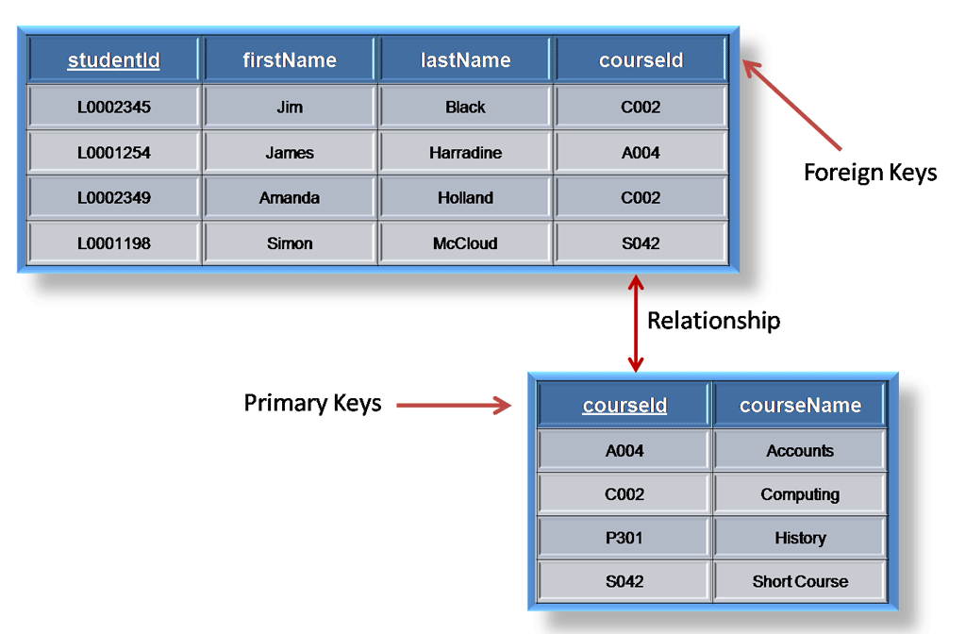
4. Relational Databases :
In this database, every piece of information has a relationship with every other piece of information. This is on account of every data value in the database having a unique identity in the form of a record.
Note that all data is tabulated in this model. Therefore, every row of data in the database is linked with another row using a primary key. Similarly, every table is linked with another table using a foreign key.
Refer to the diagram below and notice how the concept of ‘Keys’ is used to link two tables.
Due to this introduction of tables to organize data, it has become exceedingly popular. In consequence, they are widely integrated into Web-Ap interfaces to serve as ideal repositories for user data. What makes it further interesting is the ease in mastering it, since the language used to interact with the database is simple (SQL in this case) and easy to comprehend.

Slide 8
5. NoSQL Databases :
A NoSQL originally referring to non SQL or non-relational is a database that provides a mechanism for storage and retrieval of data. This data is modeled in means other than the tabular relations used in relational databases.
The data structures used by NoSQL databases are different from those used by default in relational databases which makes some operations faster in NoSQL. The suitability of a given NoSQL database depends on the problem it should solve. Data structures used by NoSQL databases are sometimes also viewed as more flexible than relational database tables.
MongoDB falls in the category of NoSQL document-based database.
examples:JSON

Slide 9
Database Browser for SQLite:
Database software builds indexes as data is added to the database so as to provider quicker access to particular entry.
In this course of study, SQLite is used because it is already built into Python.
SQLite is a C library that provides a lightweight disk-based database that doesn’t require a separate server process and allows accessing the database using a non-standard variant of the SQL query language.
SQLite is designed to be embedded into other applications to provide database support within the application. For example, the Firefox browser also uses the SQLite database internally. SQLite is well suited to some of the data manipulation problems in Informatics such as the Twitter spidering application etc.
Many of the operations on SQLite database files can be easily done with the help of software called Database Browser for SQLite
Using this browser, one can easily create tables, insert data, edit data, or run simple SQL queries on the data in the database. This database browser is similar to a text editor when working with text files.
When you want to do one or very few operations on a text file, you can just open it in a text editor and
make the changes you want.
➢
When you have many changes that you need to do to a text file, often you will write a simple Python
program. You will find the same pattern when working with databases. You will do simple operations in
the database manager and more complex operations will be most conveniently done in Python.

Slide 10
THANK YOU

